Slide 1
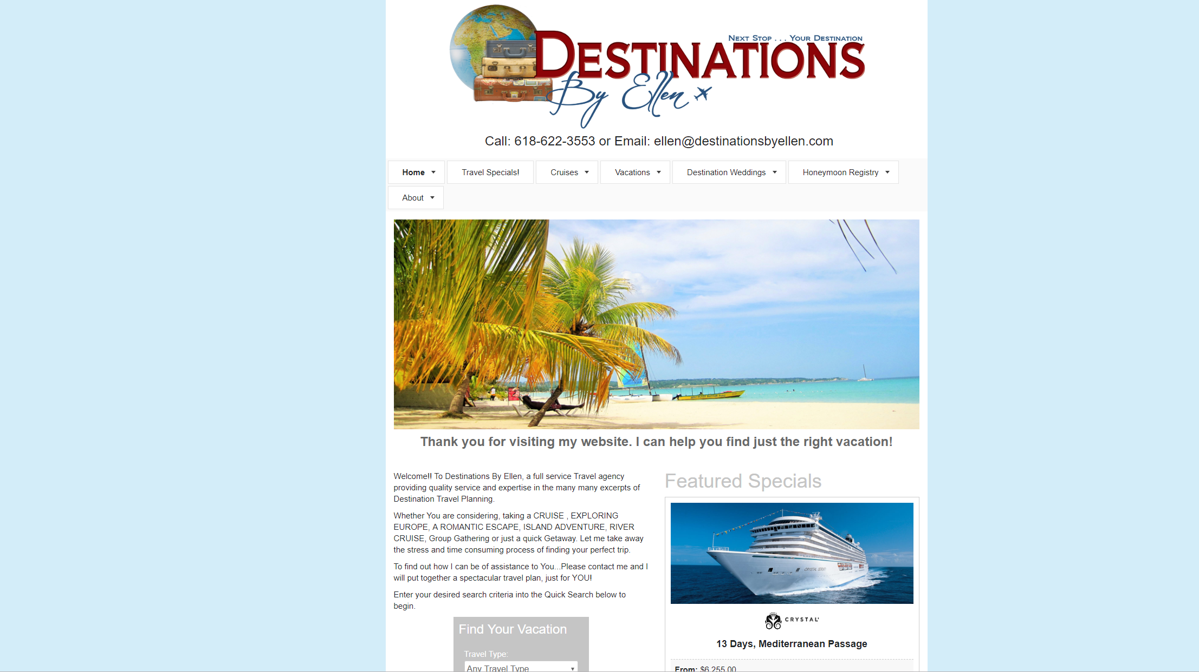
Destinations by Ellen

Slide 2
Objective
Redesign website for modern feel.
Make responsive design enabling mobile support.
Make website feel more “adventure” based.
Integrate information database incorporated with full service travel agency.

Slide 3
Target Audience
Middle to high-income individuals, couples and families looking for travel experiences.

Slide 4
Expected Outcome/Benefits
More cohesive web experience.
Make responsive website for ease of use.
Allow more information to be better organized for customers.
Target younger, more adventurous audience as well as more seasoned travelers.

Slide 5
Project Description
Project redesign will begin by with meeting with client for design ideas and expectations. From this meeting, low fidelity sketching will be created followed by wireframing of the most favored designs. After the structure is determined, prototyping with minimal functionality will follow for design style finalization. Once the design is selected and approved, the product will be prototyped with full functionality for final approval. From there, the design will be moved to the web design process for creation of a completed web design for publishing.

Slide 6
Flow Chart
Travel Packages
Home
Destinations
Cruises
Our Team
Cruise Lines
Contact Us

Slide 7
Theming, Color and Typography
Fonts:
Futura
Papyrus
Colors:
#8C0408
Sangria
#6D8EA5
Dusty Blue
#FFFFFF
White
#873022
Burnt Orange
#283242
Navy

Slide 8
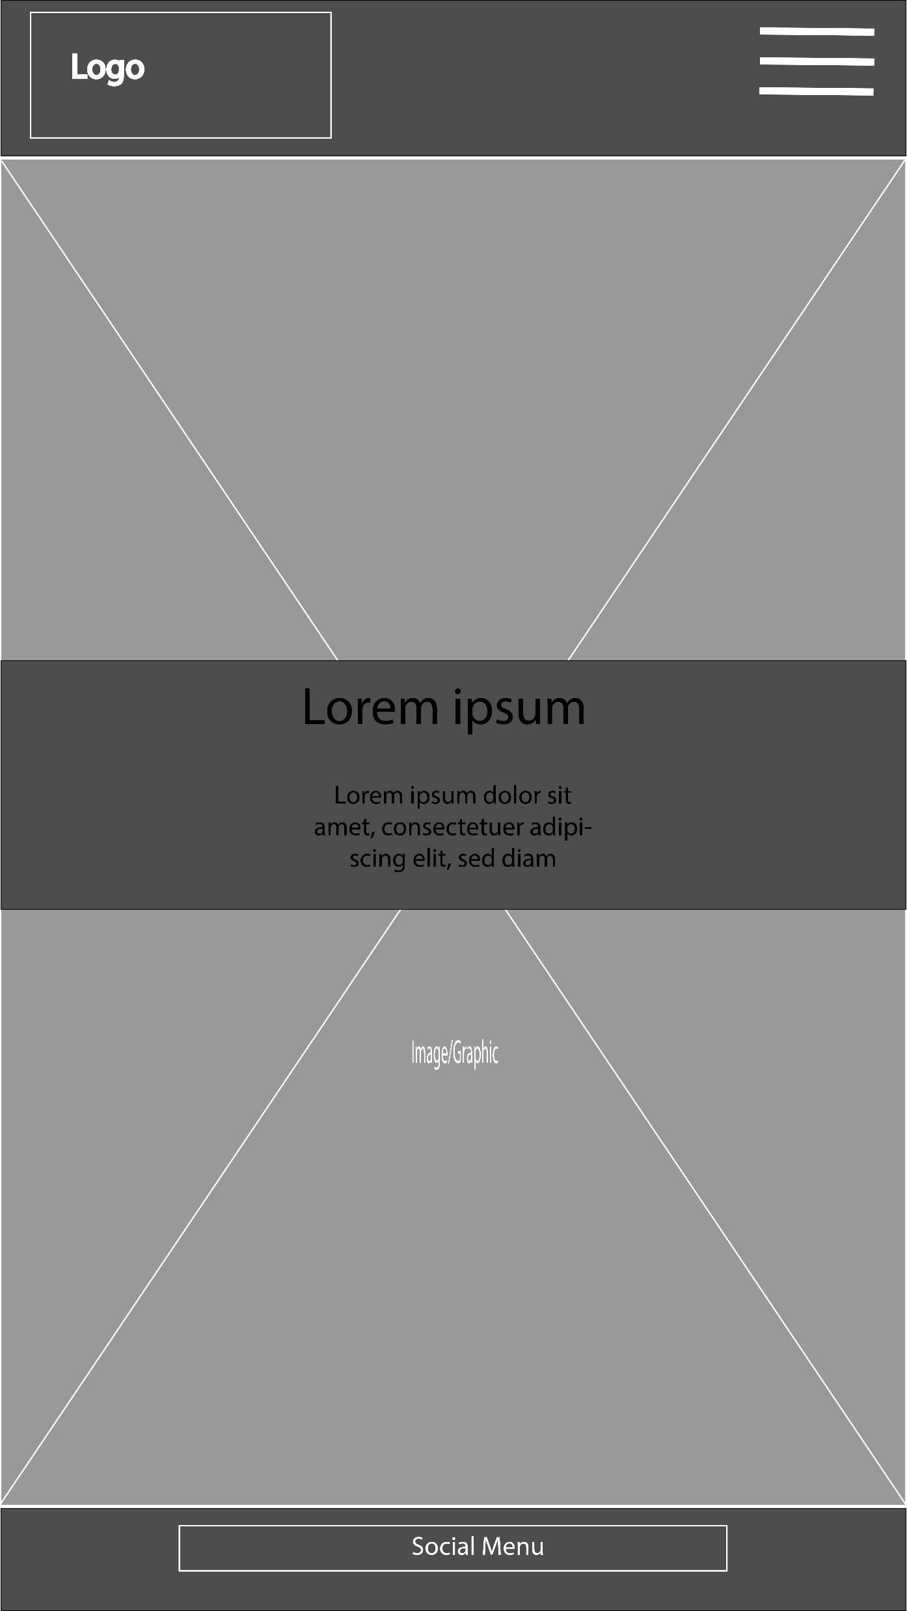
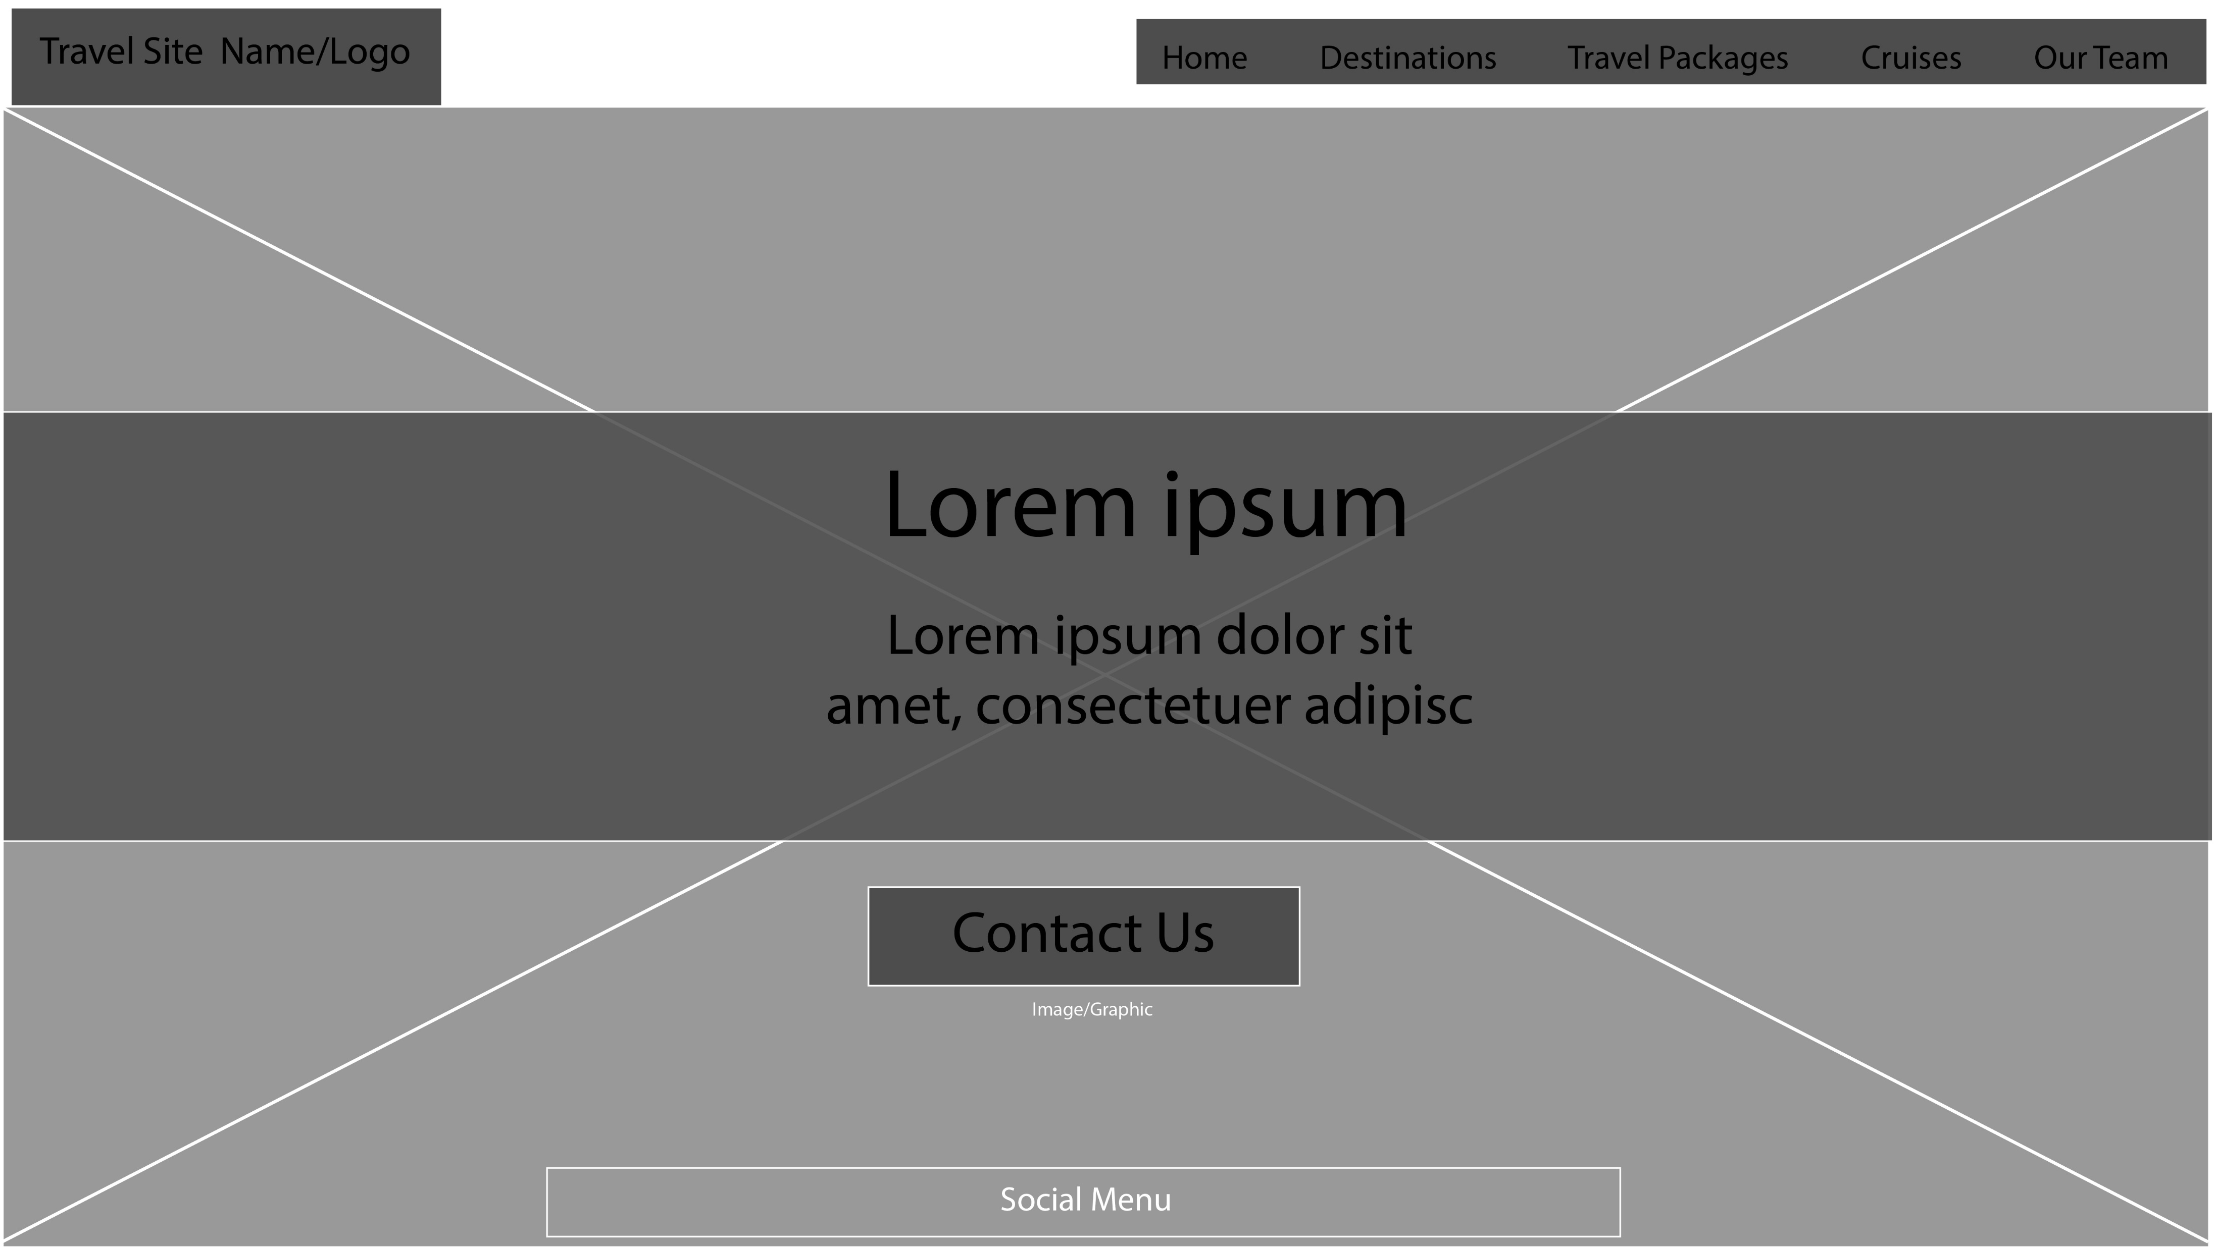
Wireframes

Slide 9
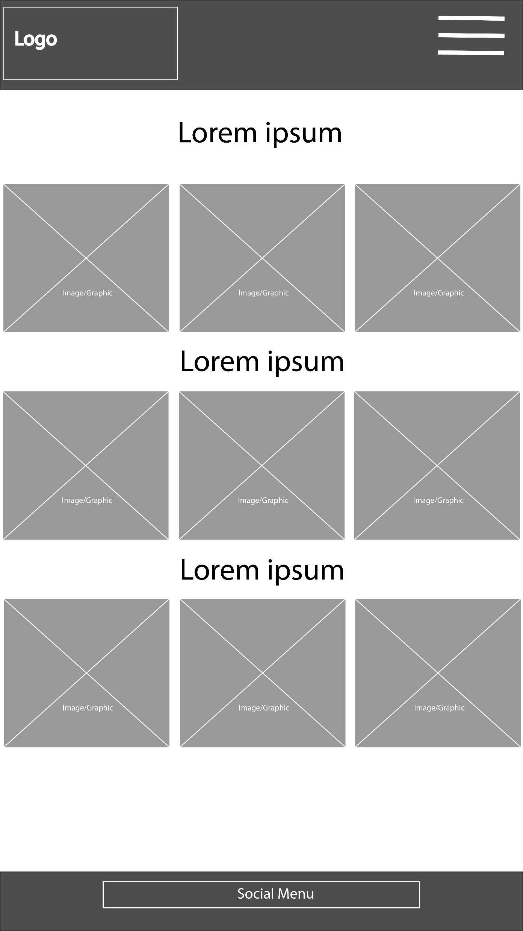
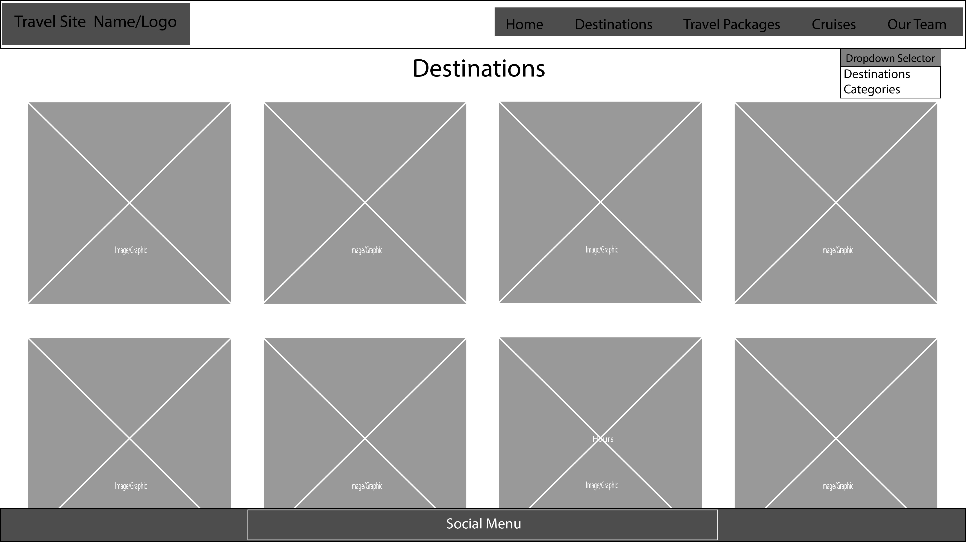
Wireframes

Slide 10
Prototypes
Desktop v1
Mobile v1
Desktop v2
Mobile v2

